Slide 1


Tutorial
Layout Design
VLSI Design 2023

Slide 2


Layout Design
Making of Transistors from silicon
CMOS Fabrication - Javatpoint

Slide 3
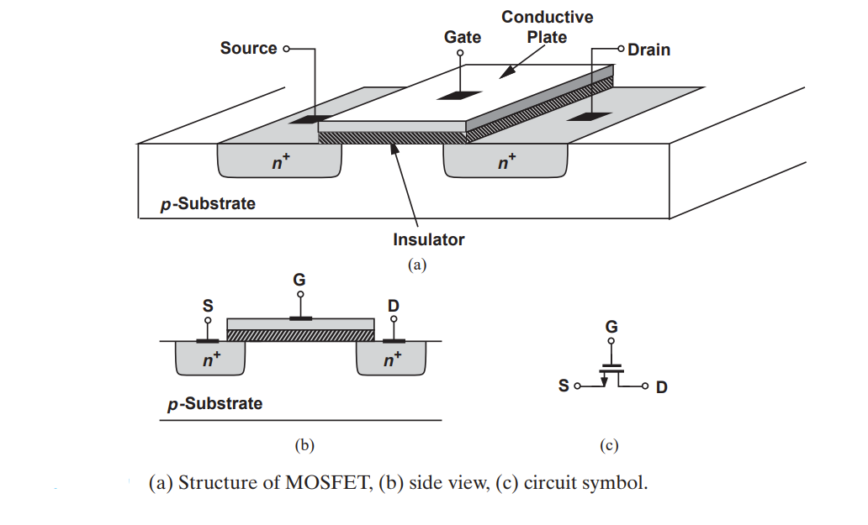
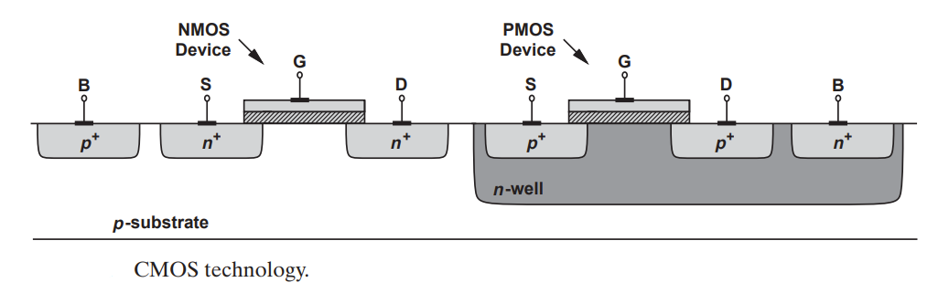
Steps involved in the preparation of MOSFET

Slide 4
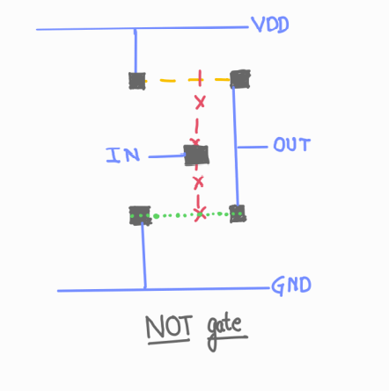
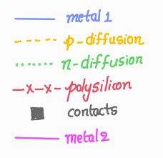
Inverter Stick Diagram

Slide 5
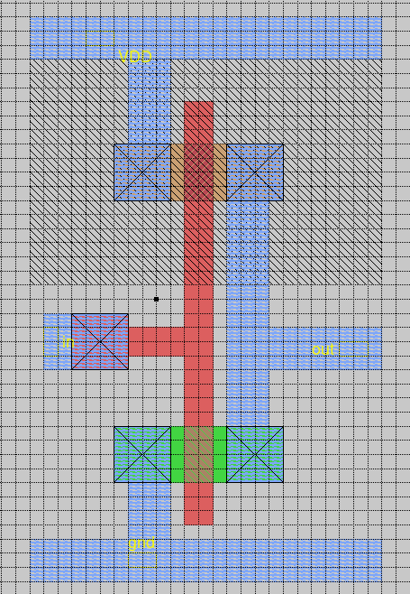
Inverter Layout

Slide 6
Any More Questions?

